Slide 1
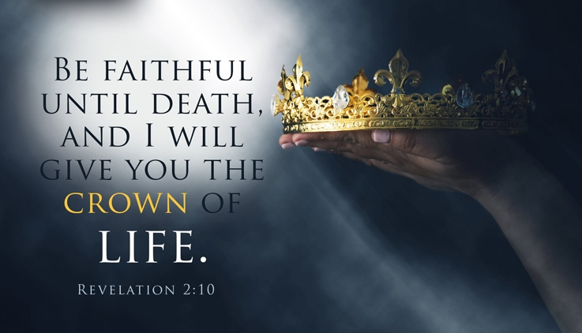
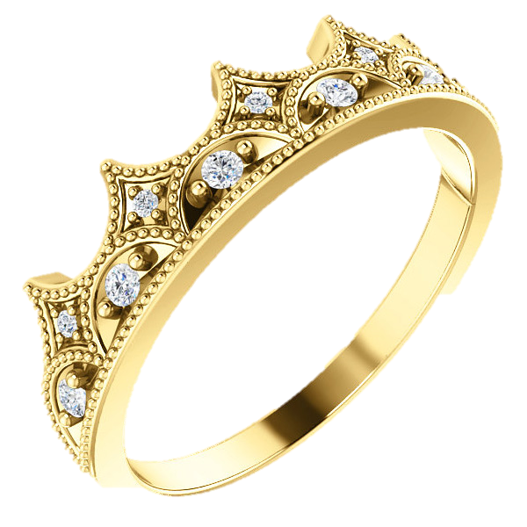
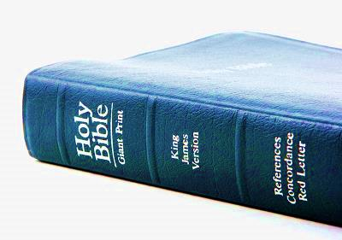
CROWNS & REWADS
From THE JUDGMENT THRONE OF YAHUSHA
(All Scriptures are from the KJV unless otherwise noted.)
Notes:
Final edit 430 july 24/20

Slide 2
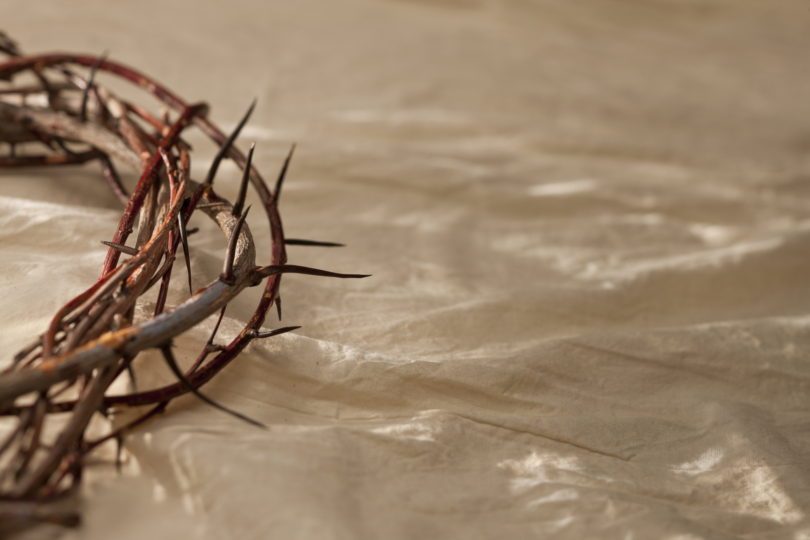
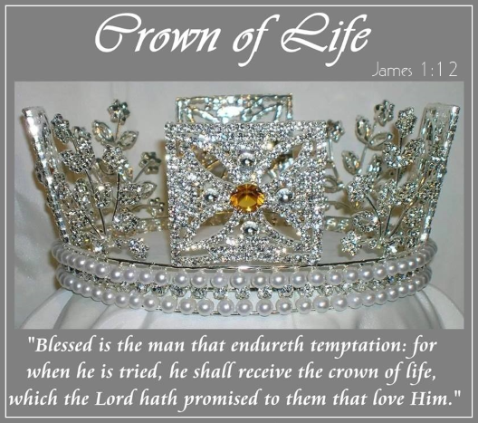
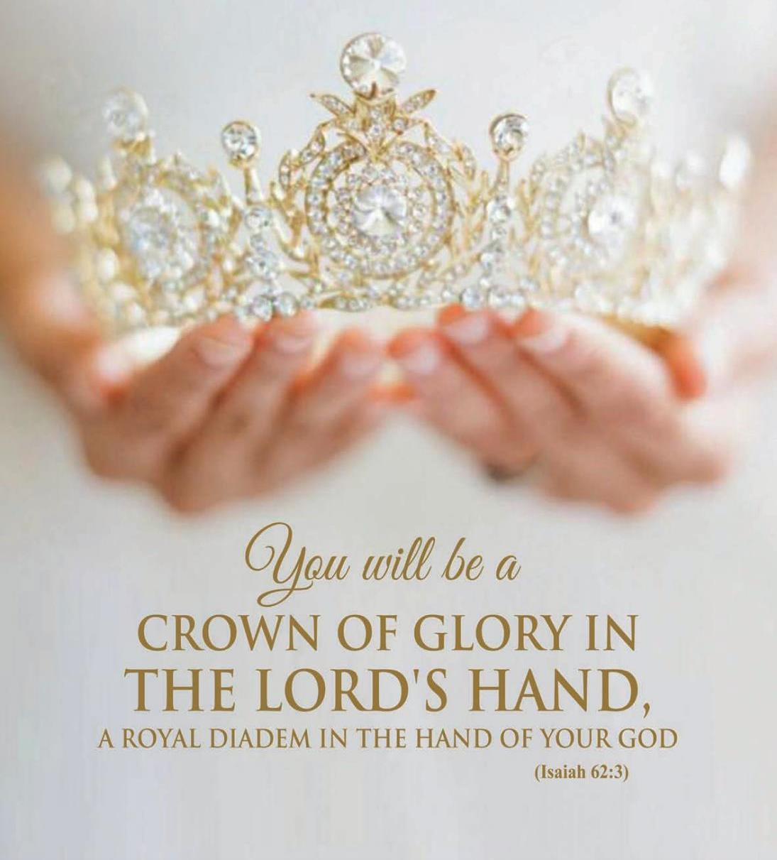
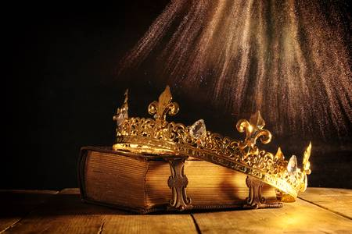
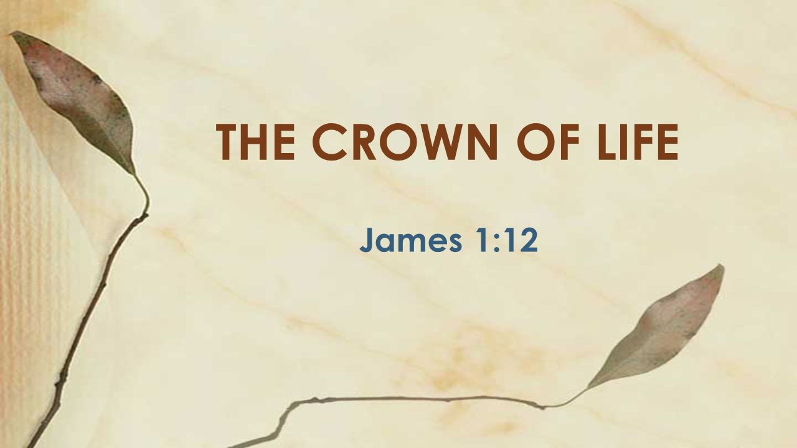
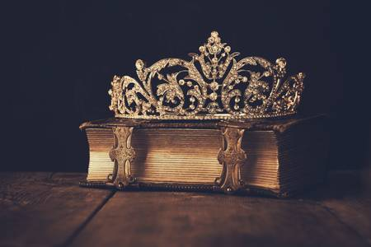
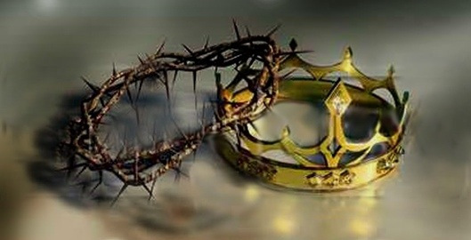

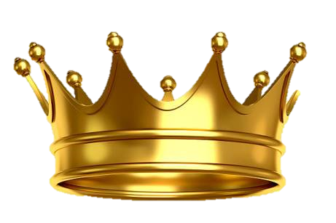
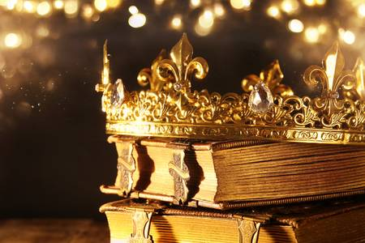




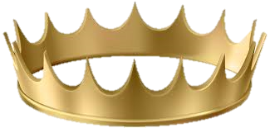
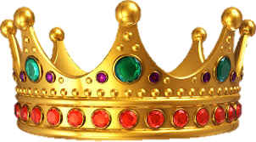
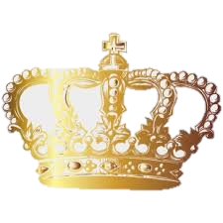

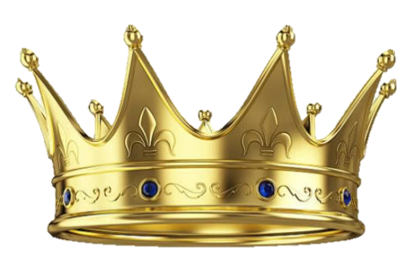
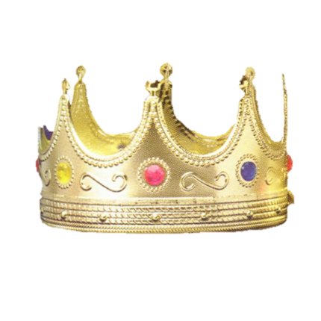
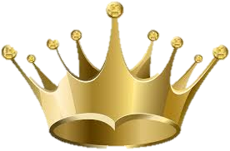

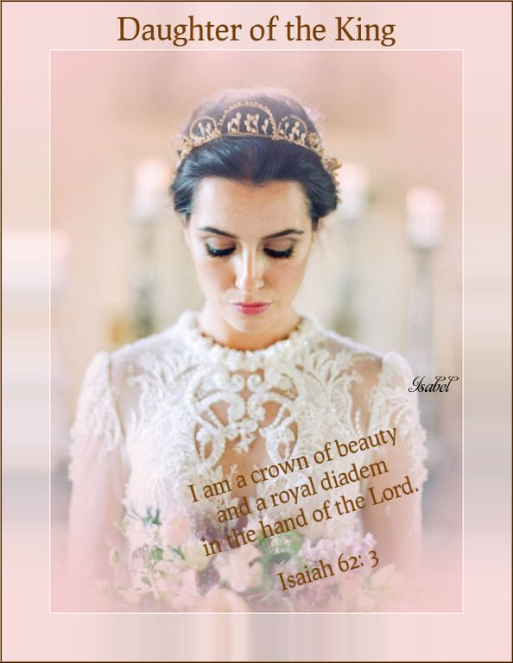
This is a study from:
Yahusha’s Crown
to Our Crown
There are many crowns in this world,
but the “crown of thorns” is the most beautiful of all! However, Yahusha has a special crown for each of His children. What will this crown be?

Slide 3
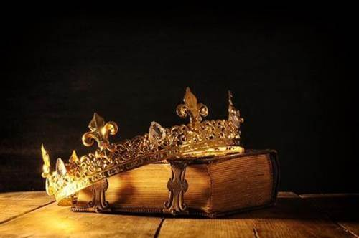
1 Tim 2:3-4 For this is good and acceptable in the sight of Yahusha our Saviour; 4 Who will have all men to be saved, and to come unto the knowledge of the truth. KJV
James 1:12 Happy is the man who doesn't give in and do wrong when he
is tempted, for afterwards he will get as his reward the crown of life that Yahuwa has promised those who love him. TLB
What about
this verse?
2 Tim 3:7
Ever learning,
and never able
to come to
the knowledge
of the truth.
KJV
Is there a crown/reward for these people too?

Slide 4
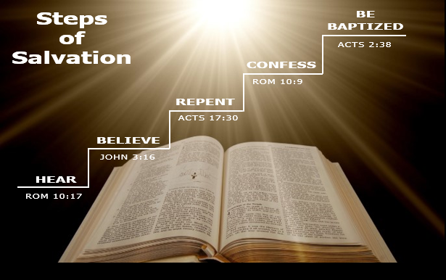
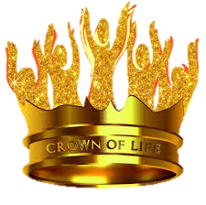
Be Baptized
Confess
Then Peter said unto them, Repent, and be baptized every one of you in the name of Yahusha our Saviour for
the remission
of sins …
Repent
That if thou shalt confess with thy mouth our Messiah Yahusha, and shalt believe in thine heart … thou shalt
be saved.
Believe
And the times of this ignorance Yahuwa winked at; but now commandeth all men every where to repent …
Hear
For Yahuwa so loved the world, that he gave his only begotten Son, that whosoever believeth in him should not perish, but have everlasting life.
So then faith cometh by hearing, and hearing by the
word of Yahuwa.
Then What?
Is there another Crown?
Are there other Rewards?

Slide 5

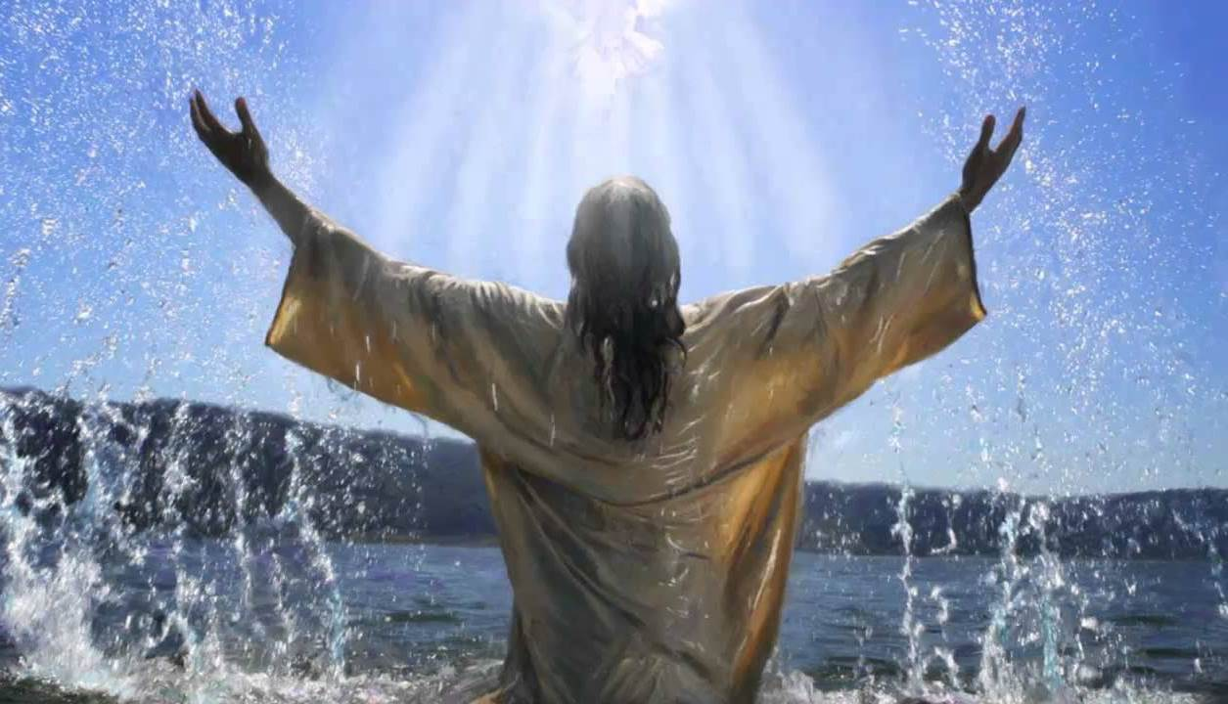

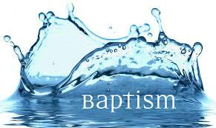
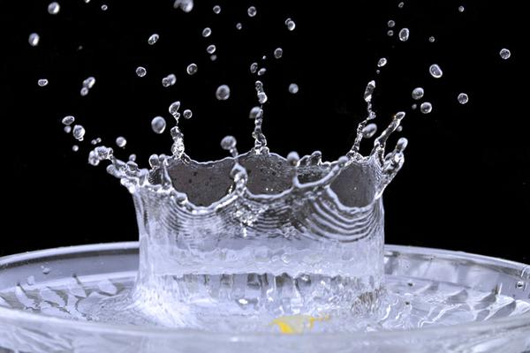
Yahusha is our Example for baptism.
Baptism is our first step towards Yahusha’s crown for us.

Slide 6
What is the connection between the crown and/or reward?
Yahuwa Wants ALL to Have Salvation
Rom 10:9 That if thou shalt confess with thy mouth Yahusha ha Mashiach, and shalt believe in thine heart … thou shalt be saved.
Rom 10:13 For whosoever shall call
upon the name of Yahusha shall be saved.
1 Tim 2:3-4 For this is good and acceptable in the sight of Yahusha
our Saviour;
4 Who will have all men to be saved,
and … [we’ll finish the verse later]
Yahusha’s Commission: “go and Baptize”
Matt 28:19-20 Go ye therefore, and teach
all nations, baptizing them …
[we’ll finish verse 20 later]
Outward Testimony of Salvation
Mark 16:16 He that believeth and is baptized shall be saved; …
QUESTION:
Would each person have the
Crown of Life at that point?

Slide 7
What happens with baptism?
What happens after baptism?
Gift of Baptism
Rom 5:10, 11, 9 (in this order) 10 For if,
when we were enemies, we were reconciled to Yahuwa by the death of his Son, much more, being reconciled, we shall be saved by
his life.
11 And not only so, but we also joy in Yahuwa through Yahusha our Messiah, by whom we
have now received the atonement.
9 Much more then, being now justified by
his blood, [at that moment of baptism] we
shall be saved from wrath through him.
Follow-up After Baptism
1 Tim 2:3-4 For this is good and acceptable
in the sight of Yahusha our Saviour;
4 Who will have all men to be saved,
and to come unto the knowledge of the truth.
Matt 28:19-20 Go ye therefore, and teach all nations, baptizing them …
20 Teaching them to observe
all things whatsoever I have commanded you …
after baptism there is more to learn!

Slide 8
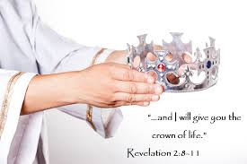
John 3:36[a] Sums Up One Thought
(Comparing Several Scripture Versions – Part 1)
John 3:36 [1st Part - KJV]
He that believeth on the
Son hath everlasting life:
John 3:36 [1st Part – Other Versions]
Whoever believes in the Son has eternal life, NIV
He who believes in the Son has everlasting life; NKJV
The man believing to the Son has life continual; ANT
He that believeth on the Son hath eternal life; ASV
He who believes in the Son has eternal life; NAS
And all who believe in Yahuwa’s Son have eternal life. NLT
He who believes in the Son has eternal life; RSV
Whoever believes in the Son has eternal life; TEV
And all who trust him- Yahuwa’s Son-to save them have eternal life; TLB
He who believes in the Son possesses everlasting life … ISR
This part of John 3:36
speaks of “salvation” - NOT - “once saved – always saved!”
Notes:
ANT = Accurate New Testament

Slide 9
Does John 3:36[b] in the KJV Agree with
Several Other Scripture Versions? Let’s examine Part 2 of John 3:36!
John 3:36
[2nd Part Problem - KJV]
… and he that believeth [obey?] not the Son shall not see life; but the wrath of Yahuwa abideth on him.
John 3:36 [2nd Part – Other Versions]
but whoever REJECTS the Son will not see life, for Yahuwa’s wrath remains on him. NIV
he who does not believe the Son shall not see life, but the wrath of Yahuwa abides on him. NKJV
The man but not BELEIVING the Son, not will see life … ANT [Accurate New Testament]
But he that OBEYETH not the Son shall not see life, but the wrath of Yahuwa abideth on him. ASV
but he who does not OBEY the Son shall not see life, but the wrath of Yahuwa abides on him. NAS
Those who don't OBEY the Son will never experience eternal life. NLT
he who does not OBEY the Son shall not see life, but the wrath of Yahuwa rests upon him. RSV
Whoever DISOBEYS the Son will not have life, but will remain under Yahuwa's punishment. TEV
Those who don't believe and OBEY Him shall never see heaven, but the wrath of Yahuwa
remains upon them. TLB
But he who does not OBEY the Son shall not see life, but the wrath of Elohim remains on him. ISR
This is true!
But, what do
other Bible Versions
have to say?
Note: 7 of 10 other Bible Versions show obedience is part of eternal life –
after the gift of salvation has been received [through the 5 steps to baptism]!

Slide 10
Salvation Is received at baptism … but is salvation retained?
John 3:36
[1st Part - KJV]
He that believeth on the Son hath everlasting life:
John 3:36
[2nd Part - KJV]
… and he that believeth not the Son shall not see life; but the wrath of Yahuwa abideth on him.
Here the KJV also records there is no
everlasting life for not believing on the Son.
This is ALSO correct!
Here the KJV records everlasting life for believing on the Son.
This is correct!
BUT, the question is this: Once a person is given salvation, is their salvation secure on this earth, IF they do not choose to grow
in Yahusha and follow ALL of His Torah instructions?
What about the words: “depart from me, I never knew you”?

Slide 11
John 3:36 should have this message in every single revision or translation!
“He who believes in the Son possesses everlasting life, but he who
does not OBEY the Son shall not see life, but the wrath of Elohim remains on him.” ISR
The first part of John 3:36 is the FIRST step of salvation.
What does this mean? Upon baptism one receives their
“robe of righteousness.”
However, the last part of John 3:36 does NOT mean
permanent eternal salvation at this point of baptism. WHY?
If they choose to exchange that “robe” for their own filthy rags
[by their disobedience], then at that point their eternal salvation comes into question!
Notes:
ANT = Accurate New Testament

Slide 12
This is an Entry level presentation based on the correct meaning of John 3:36
This is a huge topic that will be based on the full & complete meaning of John 3:36 – of what is to happen after the point
of baptism. This is when one receives the Crown of Life
for the first time. Therefore this study concentrates on the rewards that each can choose to attain in their walk thereafter.
This study could then be further expanded around the “obedience component” after the decision of baptism.
Consideration should be given to those that resist obedience. [This is not the topic of study for this presentation at this time.]
We are now ready for the “Introduction” to this study.

Slide 13
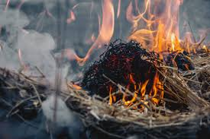
INTRODUCTION
“For we must all appear before the judgement seat of Yahusha; that every one may receive the things done in his body, according to that he hath done, whether it be good or bad”
(2 Cor 5:10).
Yahusha will sit at the “reviewing” stand.
If, after being born again (John 3:3), we live a life of faithful service to Yahusha, a life rich in His good works through us, Yahusha will reward us at his judgment throne!
At the judgment seat of Yahusha, we will be rewarded - or - our own works will burn as hay. Would there be
a reward in such a case?

Slide 14
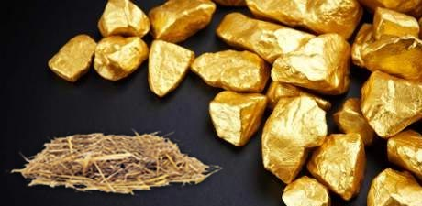
INTRODUCTION (Con’t) in 1Cor 3
10 According to the grace of Yahuwa which is given unto me, as a wise masterbuilder, I have laid the foundation, and another buildeth thereon. But let every man take heed how he buildeth thereupon.
11 “For other foundation can no man lay than that is laid, which is Yahusha
our Messiah.
12 Now if any man build upon this foundation gold, silver, precious stones,
wood, hay, stubble; (1 Cor 3:10-12)

Slide 15

INTRODUCTION (Con’t) in 1Cor 3
“Every man’s work shall be made manifest: for the day shall declare it; because it shall be revealed by fire; and the fire shall try every man’s work of what sort it is” (1 Cor 3:13).
“If any man’s work shall be burned, he shall suffer loss: but he himself shall be saved; yet so as by fire” (1 Cor 3:15).
“If any man’s work abide” Paul said, “he shall receive
a reward” (1 Cor 3:14).
What is
that reward?

Slide 16
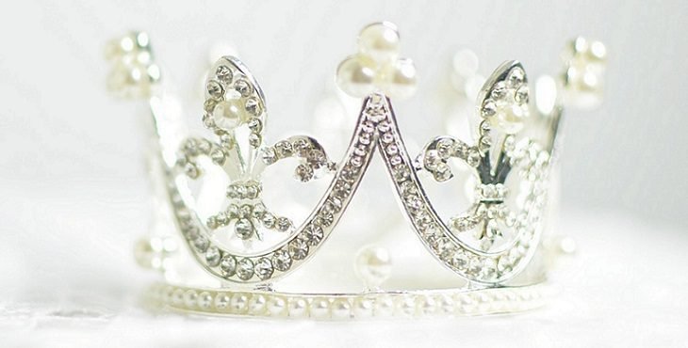
LET US LOOK AT SUCH
“REWARDS” OR “CROWNs”
16

Slide 17
What is the Difference between SALVATION and REWARDS for BELIEVERS?
THERE IS A VAST DIFFERENCE BETWEEN THE DOCTRINE OF SALVATION
FOR THE LOST, AND THE DOCTRINE OF REWARDS FOR THE SAVED.
Salvation is free through the blood of
Yahusha for everyone that accepts.
Salvation is received by faith in what
Yahusha did on the tree.
“This is my blood…which is poured out for many for the forgiveness of sins” (Matt 26:28).
Salvation is “the gift of Yahuwa.” Salvation is never earned by our works. (Eph 2:8, 9)
“…Yahusha died for our sins according
to the Scriptures” (1 Cor 15:3).
When 1 believe that the blood Yahusha shed on the tree was the full payment for my sin, I have everlasting life [at that point in time] (John 3:36a).
“Rewards” given to the saved are according to their outward works through the gifts that Yahusha has given them.
17

Slide 18
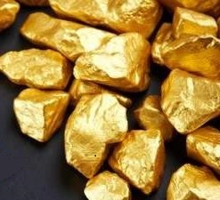

REWARDS ARE EARNED
Rewards are according to the works of the believer (Matt 16:27).
The Scripture verses from 1 Cor 3:8-15 give a most revealing insight into rewards:
Rewarded For Labor. Every believer
will be rewarded according to his own labor (vs 8).
We do not labor for salvation.
Yahuwa’s fellow workers. “We are Yahuwa’s fellow workers” (vs 9)
- not for salvation, but for rewards.
Build On YAHUSHA. The believer is to build on YAHUSHA - the only foundation (vs 11).
Choice of materials. The believer has a
choice of two main types of building materials:
“gold, silver, precious stone”
- eternal materials;
or wood, hay, straw”
- temporal materials
(1 Cor 3:12 &
2 Cor 4:18).

Slide 19
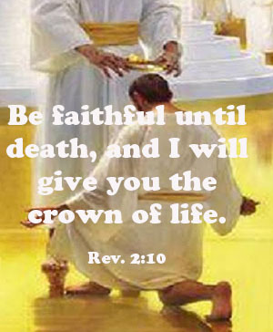
Receive a reward
The believer who builds on YAHUSHA with eternal materials; “gold, silver, precious stones,” will receive a reward (1Cor 3:14).
Those who build on YAHUSHA with temporal materials; “wood, hay, straw” will receive NO reward. Their works of “wood, hay and straw” will be destroyed at the “judgment seat of YAHUSHA” (2 Cor 5:10); that believer will suffer loss - not the loss of salvation, but the loss of his crown or his reward (1Cor 3:15).
19

Slide 20

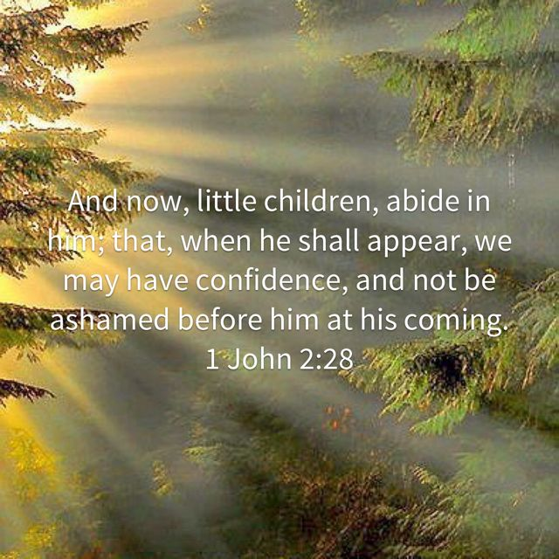
Ashamed at his coming
YAHUSHA has given every believer a job
to do. If we ignore His commands, we will be very sad and frightened when we stand before Him at the judgment! Note John’s warning:
We must be deeply rooted in YAHUSHA.
as He is the “Roots” from the beginning
(see John 15:5, 8).
The word “ashamed” means ”to shrink back in fear and lose face.” Some believers will shrink back from YAHUSHA in shame at His coming because of their fruitless lives.
They were fruitless because they were not “deeply rooted” in YAHUSHA. (See Col 2:7; Matt 13:3-10; 18-23).
The word “abide” means to be like
a tree whose roots go deep so it
can bear much fruit.

Slide 21
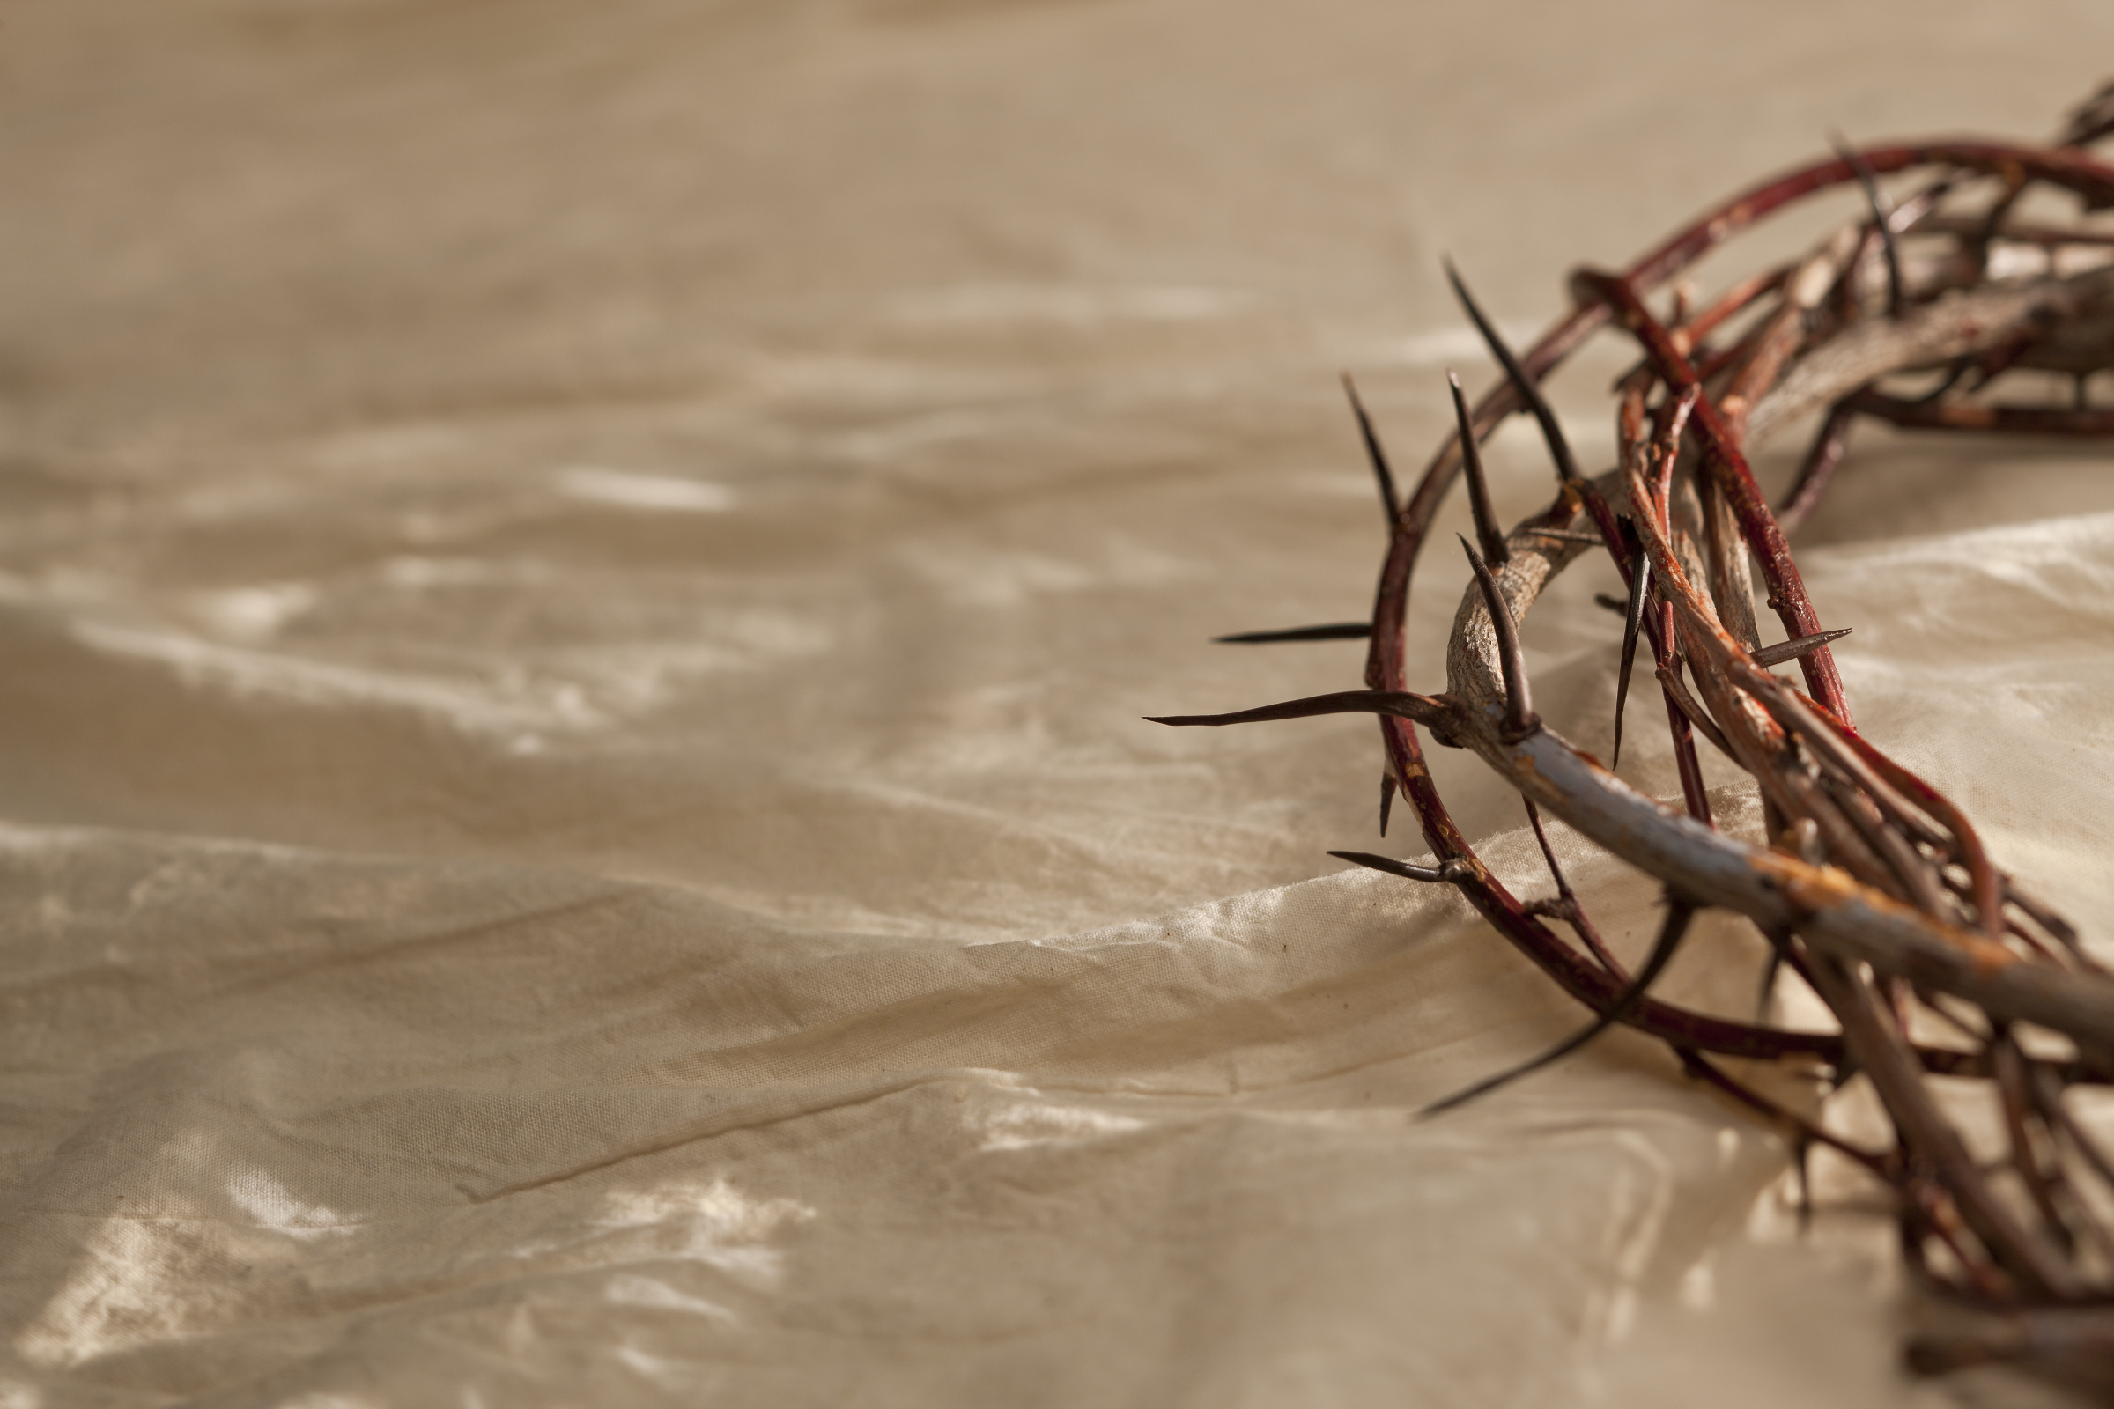
SEVEN CROWNS BELIEVERS CAN
Receive from Yahusha
The Crown of Life
The Imperishable Crown
The Crown of Rejoicing
The Crown of Righteousness
The Crown of Glory
The Overcomer’s Crown
The Martyr’s Crown

Slide 22
#1 – the crown of life
“Blessed is the man who perseveres under trial, because when he has stood the test, he will receive the crown of life that YAHUWA has promised to those who love him” (James 1:12).
This reward could be called the crown of those who love YAHUWA.
Do those who love YAHUWA use His blessings only for themselves, or pray only for their own prosperity and comfort, or demand that He solve all their problems? No—they show it by enduring trials for
His sake.
Through their love for YAH, the believer finds strength to overcome temptation
and persevere when trials come.
22

Slide 23
#1 – the crown of life
(Continued)
PAUL said, “We also glory in tribulations.”
Do we glory in tribulations?
We can do so only if the “Love of YAH has been poured out in our hearts” by the “Ruach Ha Kodesh” (Rom 5:3-5).
Without Love for YAH in the heart of the believer, trials can cause him to become bitter
and critical; he may lose the
“Crown of Life.” (vs 12).
23

Slide 24
#1 – the crown of life
(Continued)
Faithful unto death:
All believers have eternal life (John 3:15,16), but not all believers will be rewarded with the crown of life. “This crown will be given to those who are faithful [as being obedient to ALL instructions & commands] until death” (Rev 2:10 & Rev 22:14).
To receive the “crown of Life,” the believer must love YAHUSHA more than his
own life. “For whoever desires to save his life will lose it, but whoever loses his
life for my sake and the gospel’s will save it” (Matt 8:35).
This reward will be given to those who live for YAHUSHA, pressing forward to endure temptations, in the power of the love of YAH (1 Cor 10:13).
24

Slide 25
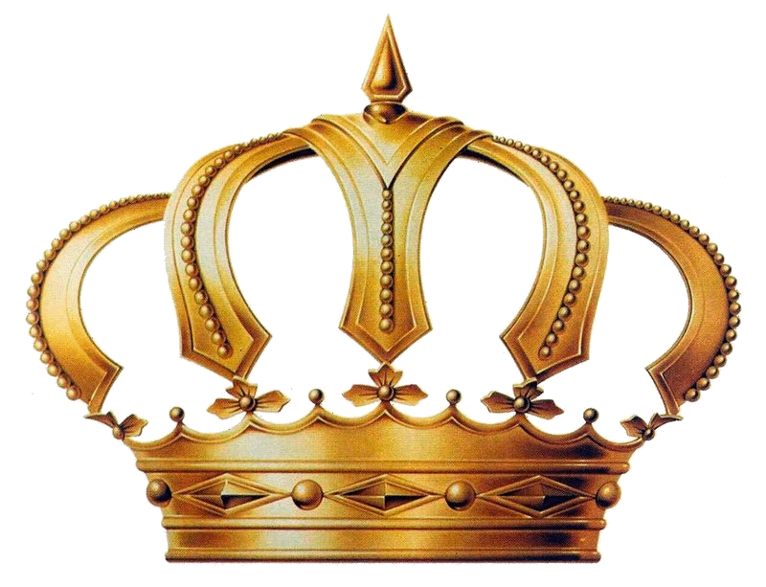
#2 – the imperishable crown
Do you not know that in a race all the runners run, but only one gets the prize? Run in such a way as to get the prize. Everyone who competes in the games
goes into strict training. They do it to
get a crown that will not last. But we
do it to get a crown that will last forever.
“Therefore I do not run like a man
running aimlessly, I do not fight like
a man beating the air.”
“No, I beat my body and make it my slave so that after I have preached to others,
I myself will not be disqualified for the prize” (1 Cor 9:24-27).
Run To Win! The Runner’s Crown
is given to the believer who disciplines himself and keeps his body and bodily desires under strict control.
Just as an athlete disciplines himself so that he can win the race, so we run the race that is set before us (Heb 12:1).

Slide 26
#2 – the imperishable crown
(Continued)
Just as the athlete must deny himself many gratifications of the body, so the believer must “discipline his body and bring it into subjection” or he will “be disqualified” (1 Cor 9:27).
He will not lose his salvation, but he
will lose this reward. YAHUSHA has
a special reward for the believer
who struggles and battles to resist temptation. Here is how to win
the “imperishable crown.”
Deny Yourself. The believer must deny himself anything that would weigh him down and hold him back (Heb 12:2).
Eyes On YAHUSHA. The believer
must keep his eyes fixed on YAHUSHA,
not looking to the right or to the left
(Heb 12:2).
Strength In YAHUSHA. The believer must find his strength in YAHUSHA
(Eph 6:10-18).

Slide 27


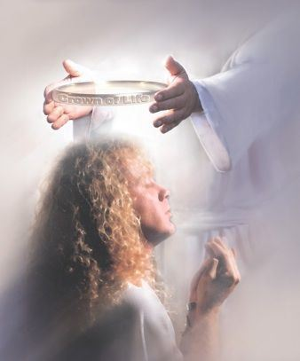
#2 – the imperishable crown
(Continued)
A living Sacrifice. The believer must give his body as a living sacrifice to YAHUSHA (Rom 12:1, 2).
Unencumbered. The believer must,
by faith, refuse anything that would impede or hinder spiritual progress. (Heb 11:24-29).
Do not be a spiritual spectator.
Enter the race; run to win the “imperishable crown.”

Slide 28
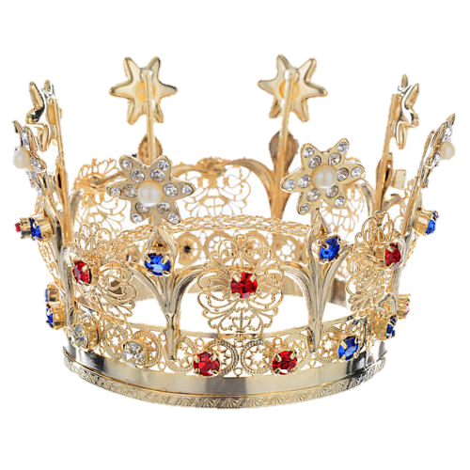
#3 – the crown of rejoicing
Given to Soul-Winners:
What is our hope, our joy, our crown
in which we will glory in the presence
of our YAHUSHA when he comes?
Is it not you (the Thessalonians, whom Paul’s missionary work had won for YAHUSHA)? “Indeed, you are our
glory and joy” (1 Thess 2:19, 20).
This crown is awarded to believers
who persuade others to believe on YAHUSHA as their Master and Saviour.
The “Crown of Rejoicing” (vs 19)
is the soul winner’s crown.
The greatest work you are privileged
to do for YAHUSHA is to bring others
to a knowledge of YAHUSHA as Saviour.
Much of your joy in heaven will be determined by the souls you have
had a part in bringing to YAHUSHA.
Paul tells the Thessalonian believers that they are his “glory and joy” ”now and when YAHUSHA comes.”

Slide 29
#3 – the crown of
rejoicing (Continued)
Reasons for Winning Souls
It Is Wise. It is wise to win souls to YAHUSHA (Prov 11:30).
An Attack On Sin. It is an attack on sin to win souls to YAHUSHA (James 5:20).
A Cause For JOY. It is a cause of joy in Heaven to win souls to YAHUSHA (Luke 15:10).
Shine Forever. Soul-winners will shine as the stars forever (Dan 12:3).
How You Can Win Souls:
Witness With Your Life.
Live so that others may see YAHUSHA in you (2 Cor 3:2;
Gal 2:20).

Slide 30
#3 – the crown of
rejoicing (Continued)
Witness By Your Actions:
Witness With Power. Trusting the Holy Spirit to give power to the spoken word
(Acts 1:8).
Witness By Giving Tithes and Offerings.
Your financial support will help others to preach the Word of YAHUSHA. In doing so, there is “fruit (a reward) that abounds to
your account” (Phil 4:15-17; 2 Cor 9:6).
YAHUWA has promised that
your labor will not be in vain in YAHUSHA (1Cor 15:58).
All of Heaven will rejoice
with him when he receives
the “crown of rejoicing”
(1 Thess 2:19).

Slide 31
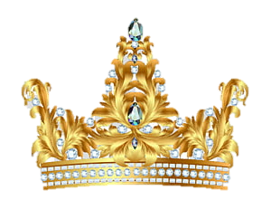
#4 – the crown of
righteousness
“Watch yourself in all things, endure affliction, do the work of the evangelist , fulfill your service. For I am now ready to be offered,
and the time of my departure is at hand. I have fought a good fight, I have kept the faith: (vs 8) And now there is laid up for me a crown of righteousness, which YAHUSHA, the righteous Judge, shall give me on that day: and not to me only, but to all Yisrael that also love His appearing” (2 Tim 4:5-8).
The “crown of righteousness” (vs 8) is a reward. It is not to be confused with the “righteousness of YAHUWA” which the believer receives when he becomes a believer.
We put our faith and trust in YAHUSHA, because “He had made Him to be the sin sacrifice for us, who knew no sin; that we might be made the righteousness of
YAHUWA in Him” (2 Cor 5:21).

Slide 32
#4 – the crown of
righteousness (Continued)
If the believer looks for, and loves the second coming of YAHUSHA, it will affect his whole life. Look at the dynamic impact this truth had on the life of the Apostle Paul. He could say:
Fight the Good Fight. “I have fought the good fight” (2 Tim 4:7 and 1 Cor 15:32). He fought a spiritual battle throughout his believers life, and won.
He never surrendered to the enemies
of righteousness (Eph 6:12).
Righteousness is imputed to all those saved by grace through faith, but the “crown of righteousness” is a reward to be earned by the saved.
They Loved His Appearing
The apostle looked ahead to the “Judgment seat of YAHUSHA” (2 Cor 5:10) where the “crown of righteousness” will be given to those who “have Loved his appearing”
(2 Tim 4:8).

Slide 33
#4 – the crown of
righteousness (Continued)
They Loved His Appearing (con’t)
Finished the Race. “I have finished the race!” (vs 7). He has the course to travel, and he did not detour the high places; neither did he look back
(Luke 9:61, 62).
He finished his course with his eyes
fixed on YAHUSHA (Phil 1:6).
Kept the Faith.
“I have kept the faith.”
(vs 7) He preached the “Whole counsel of YAHUWA,” never betraying any of the great biblical doctrines (Acts 20:24-31).

Slide 34
#4 – the crown of
righteousness (Continued)
They Loved His Appearing (con’t)
Do you long for His appearing?
Do you fulfill all the duties of your ministry and evangelize?
If so, this crown is for you.
How important it is for the believer to look with a heart of Love
for the Second coming of our Saviour YAHUSHA, that he may receive
the “crown of righteousness” (vs 8).
34

Slide 35
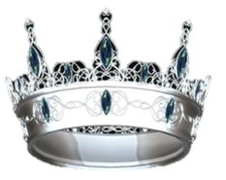
#5 – the crown of glory
“Feed the flock of YAHUWA which is among you, taking the oversight of it, not by compulsion, but willingly; not for greed, or dirty gain, but of a willing mind (1 Pet 5:2);
Vs 3 Neither as being masters over those trusted to you, but by being an example to the flock.
Vs 4 And when the Chief Shepherd shall appear, ye shall receive a Crown of Glory that fades not away.”
The Faithful Shepherd’s Crown - The “crown of glory” (vs 4) is a special reward for the Faithful and Obedient, that YAHUWA – called pastors. They will receive this reward when the Chief Shepherd appears.” It is eternal, and it does not fade away” (vs 4).
35

Slide 36
#5 – the crown of glory
(Continued)
The Faithful Shepherd’s Crown (Con’t)
Every believer may share in the pastor’s “crown of glory.” “He that receives a prophet in the name of a prophet shall receive a prophet’s reward; and he that receives a righteous man in the name of a righteous man shall receive a righteous man’s reward (Matt 10:41).
Support the Faithful, YAHUWA called pastors, by praying for them and encouraging them in the work of YAHUSHA, giving tithes and offering, and - giving freely of your time to YAHUWA’S service. YAHUWA will reward you for supporting His chosen servant by allowing you to share in your pastor’s reward.
36

Slide 37
#5 – the crown of glory
(Continued)
The Faithful Shepherd’s Crown (Con’t)
The pastor will earn this “crown of glory” by:
Proclaiming the Word: He is to proclaim the Word of YAH without fear or favor,
and when necessary, to “convince, rebuke, exhort, with all longsuffering and teaching”
(2 Tim 4:1-5).
Taking Spiritual Oversight of the Assembly: A Leader is responsible to YAH
for the message preached to his people.
No Leader should preach to please the people, but to please YAH (Gal 1: 10).
37

Slide 38
#5 – the crown of glory
(Continued)
The Faithful Shepherd’s Crown (Con’t)
Being an Example to the Assembly: He is not to serve for the reward of money. However, the assembly is responsible to care for his material needs (1 Tim 5:18).
He is to be a spiritual Leader, and not a dictator. He is to walk with YAH by faith.
“And when the Chief Shepherd appears, you will receive the crown of glory that will never fade away” (1 Pet 5:4).
  Some who are called “pastor” and have been elected and paid to be the chief administrators of organized institutional assemblies will miss this crown because of failure and sin.
38

Slide 39
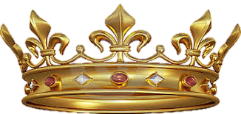
#6 – the overcomer’s crown
“See, I come quickly: hold fast to what you have, that no man takes your {keter}, or crown. Him that overcomes will I make a pillar in the temple of YAHUWA, and he
shall go out no more …” (Rev 3:11-12).
The overcomer is promised a crown if he holds steadfast to that which has
been given him by YAHUWA: It is possible to lose your overcomer’s crown.
That which should have been given to you is received by another.
Jacob received that which belonged to Esau (Gen 25:33; 27:35, 36).
Mattias received that which belonged to Judas (Acts 1:20, 26).
39

Slide 40

#7 – the martyr’s crown
“Fear none of those things that you shall suffer; see s.a.tan shall cast some of you into prison, that you may be tried; and you shall have tribulation ten days; be faithful to death, and
I will give you the crown of life” (Rev 2:10).
Those who have the high honor of giving
their life as a martyr receive this crown.
A Martyr is one who is “… slain for the
word of YAHUWA, and for the testimony
which they held” (Rev 6:9).
Stephen was the first believer in Yahusha (in the New Testament) to receive this crown (Acts 7:54-60).
Stephen means: - NT:4735 stephanos (stef'-an-os); from an apparently primary stepho (to twine or wreathe); a chaplet (as a badge of royalty, a prize in the public games or a symbol of honor generally; but more conspicuous and elaborate than the simple fillet, NT:1238), literally or figuratively: KJV - crown.
40

Slide 41
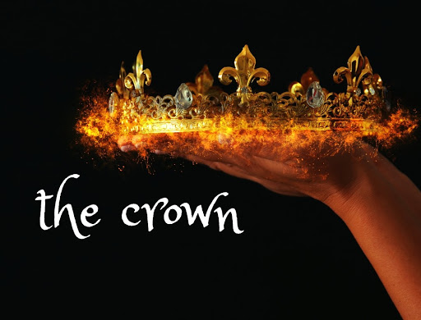
Each faithful servant will
receive a special
crown and/or reward
according to how they
manage their spiritual gifts.
Summary
41

Slide 42

Yahusha has many crowns to choose from!
Crown of Life
Imperishable Crown
Crown of Rejoicing
Crown of Righteousness
Crown of Glory
Overcomer’s Crown
Martyr’s Crown
How many of these crowns will be yours?
42

Slide 43
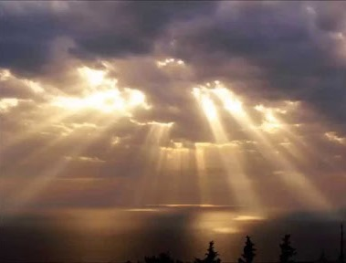
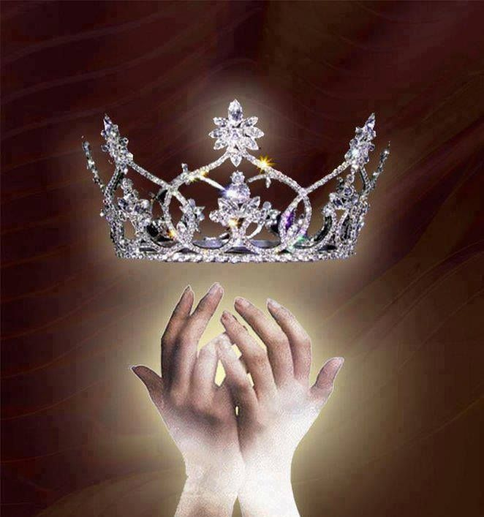
Is it possible to lose that crown,
or special reward?
YES!
43

Slide 44
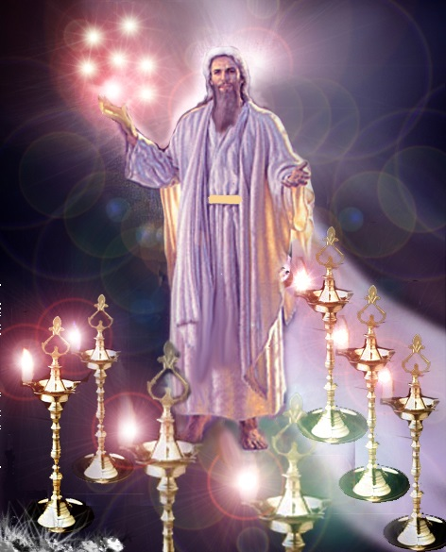
The Messages of the Seven Churches
Ephesus: The Loveless Church
Smyrna: The Persecuted Church
Pergamos: The Compromising Church
Thyatira: The Corrupt Church
Sardis: The Dead Church
Philadelphia: The Faithful Church of Brotherly Love
Laodicea: The Lukewarm Church
Only two churches retained
their crown and reward.
The End
44

Slide 45
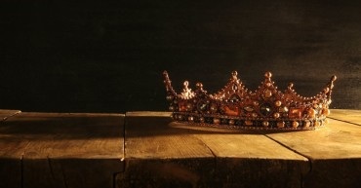
Researched by: Catherine Amponsem
Questions & Comments are Welcome!
Thank you!

Slide 46
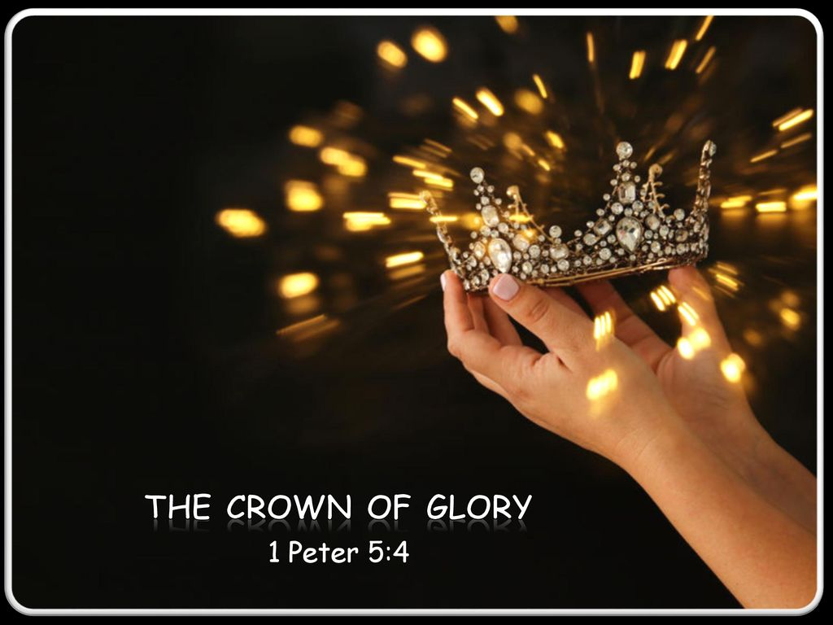
CROWNS & REWADS
From THE JUDGMENT THRONE OF YAHUSHA

